Slide 1
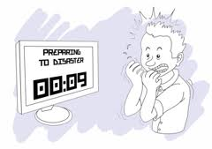

IT2775 Operations Security
Business Continuity Planning

Slide 2
Objectives
BCP/ DR (goals, why, phases)
BCP Teams
Team Training

Slide 3

Goals of BCP & DR
BCP: To maintain continual business operations despite disasters/disruptive events.
DR: To get business back to normal operations promptly after a disruptive event (disaster).
Disaster Recovery

Slide 4
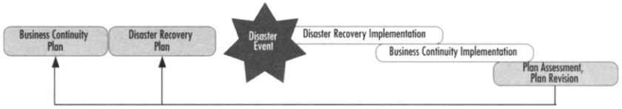
Relationship Between BCP & DR
DR is usually a part of BCP and deals with the impact immediately after the event.
DR involves stopping the effects of the disaster as quickly as possible and addressing the immediate aftermath of the disaster.

Slide 5
Why BCP?
Business interruptions cost time and money.
Customers’ needs not satisfied => go elsewhere.
  Difficult to win back lost customers, especially if the cost of switching providers is high.
DR alone is not sufficient, business continuity is required as well.
Business Impact Analysis

Slide 6
Phases of BCP?
How to resume operations from temporary location?
What workarounds are to be implemented?
Any manual methods required during this period?
Final steps in the phase - how to reintegrate or synchronize data when normal operations resume?
When to trigger activation?
Who to activate?
Activate part of the plan or entire plan?
P1. Activation
P3. Business Continuity
P4. Review
P2. Recovery
Salvage equipment and assess situation or damage.
Determine which recovery steps to take to get operations up and running again.
Activate alternative computing facilities.
Maintenance phase will occur whether or not you ever activate your BC/DR plan.
Need to review on periodic basis to ensure it is current and relevant.

Slide 7
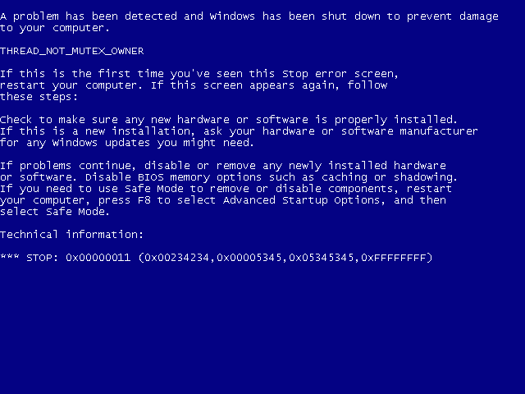

Slide 8
BCP Team
Most critical to form the right BCP team.
  Have the right balance of leadership, technical skills and business process knowledge.
e.g. Lawyer, public affairs representatives, administrative assistants, procurement specialists, etc
Assist in the planning phases of the BCP and when plan is activated.
Supporting Team Members
Identify business impact and effectively determine ways to protect business processes from risk.
Experts in business process in organization.
Business Process Team Members
e.g. System administrators, database administrators, storage engineers, security professionals, application specialists, etc
Technological solutions to incorporate as part of BCP.
Technical Team Members
Lead the team in executing BCP, collect info on incident
Team Leaders
Make decisions or escalate to senior management

Slide 9
Other Related Teams
Crisis Management Team (CMT)
  Who: Members are cross-departmental representatives in the organization.
  What:
    Decide course of action to deal with disruption. Escalate to senior management when necessary.
    Manage and monitor progress of BCP/DR.
    Delegate tasks and distribute use of resources.
    Coordinate efforts internally and externally.

Slide 10
Other Related Teams
Damage Assessment Team (DAT)
  Comprised of people from key departments such as facilities, IT, HR and operations.
  To assess the damage due to the disaster or disruption.
Emergency Response Team (ERT)
  ERT respond to actual emergencies
  Needs to be trained.
  ERT leader: Responsible for activating and coordinating emergency response plan. Member of CMT.
  ERT members: Support the emergency response with their specialized expertise.
    E.g. Responsible for monitoring network security must know how to stop the problem in the event of a breach.

Slide 11
BCP Training
BCP teams should already have the necessary technical knowledge and skills.
  Preparation is to apply these knowledge and skills in the context of an emergency.
Team can be prepared and trained as follows
  Paper simulations
  Real simulations
  Drills (announced and unannounced)

Slide 12
BCP Training
Paper Simulations
  Meeting-based simulation of incident. Sometimes called table-top exercise.
  Trainer will describe on simulated incident.
  Each member to describe the actions to be taken.
Real Simulations
  Team goes to actual site to do incident response.
  Systems are turned off to simulate real disaster.
  Where required, remote sites are activated.
  Expensive training as activity will require disruption to actual business activity.
  Done after all paper-based training to test out plan and iron out ground issues not present in paper simulations.

Slide 13

BCP Training
Drills (announced & unannounced)
  Short or no notice of disaster drill.
  Great time to do actual timing to evaluate speed of response.
  To be as realistic as possible, a few people should be aware of the drill’s existence.

Slide 14
Summary
BCP/ DR (goals, why, phases)
BCP Teams
BCP Training

